Slide 1
Economic expansion?

Slide 2
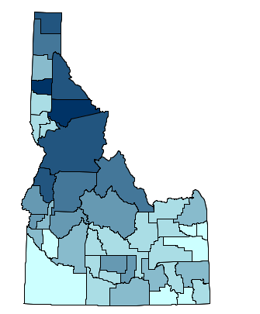
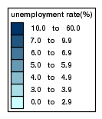
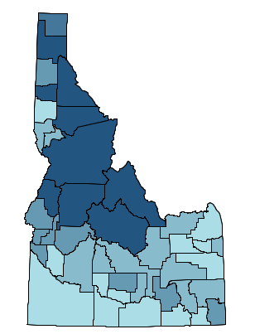
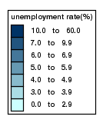
Then & Now
Then & Now
March 2007
Teton County: 2.6%
Idaho: 2.9 %
United States: 4.4%
March 2015
Teton County: 3.2%
Idaho: 3.8 %
United States: 5.5%

Slide 3
Regional Unemployment
Unemployment Series
Sources: Idaho Department of Labor and US Bureau of Labor Statistics

Slide 4
Job Growth

Slide 5
Job Growth
Percent Growth
2007 |  | 2013
-18% |  | 5%
Net Growth
2007 |  | 2013
-612 |  | 149

Slide 6
Wage Growth
Percent Growth
2007 |  | 2013
4% |  | 2%
Adjusted for Inflation
2007 |  | 2013
-8.9% |  | 0.7%

Slide 7
Industry Job Growth 2012-2022 projected 2022 net change

Slide 8
Industry Job Growth: 2012-2022 top percentage change

Slide 9
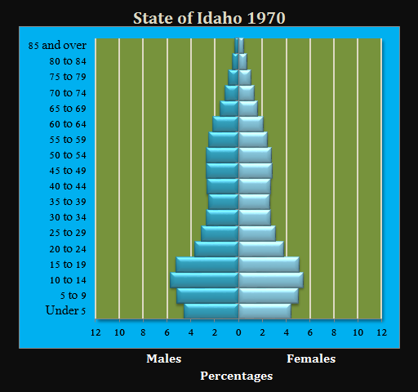
Population Trends
Notes:
Chris

Slide 10
Population Trends
Notes:
Chris

Slide 11
Population Trends
Notes:
Chris

Slide 12
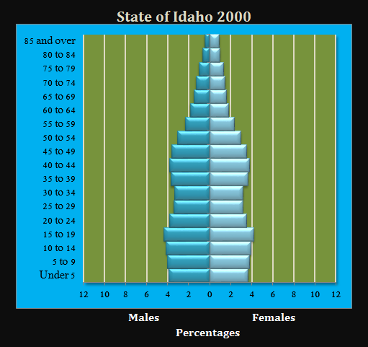
Population Trends
Notes:
Chris

Slide 13
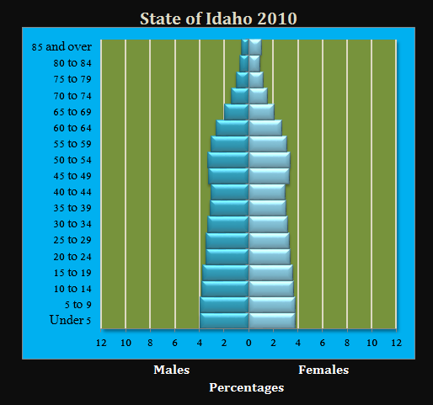
Population Trends
Notes:
Chris

Slide 14
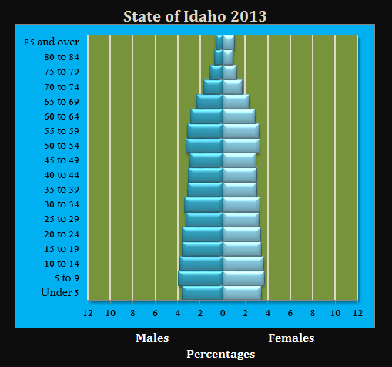
Population Trends
Notes:
Chris

Slide 15
Challenge: Labor Supply

Slide 16
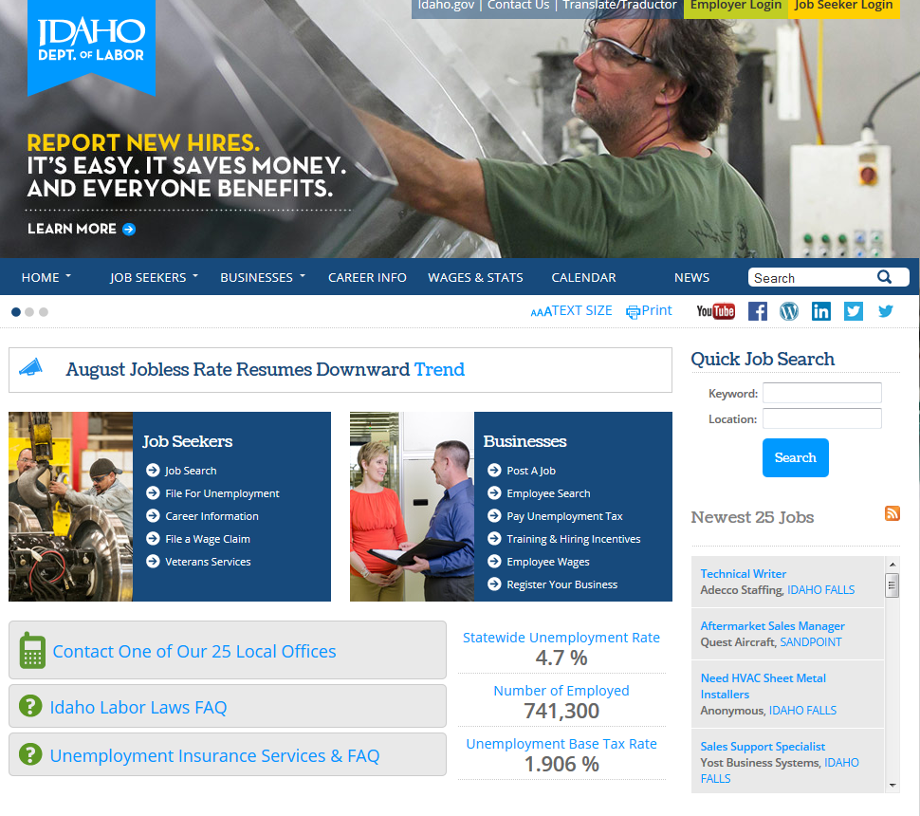
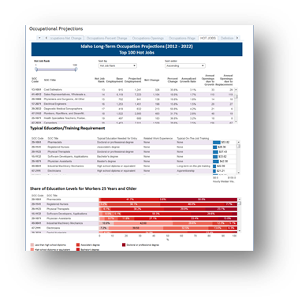
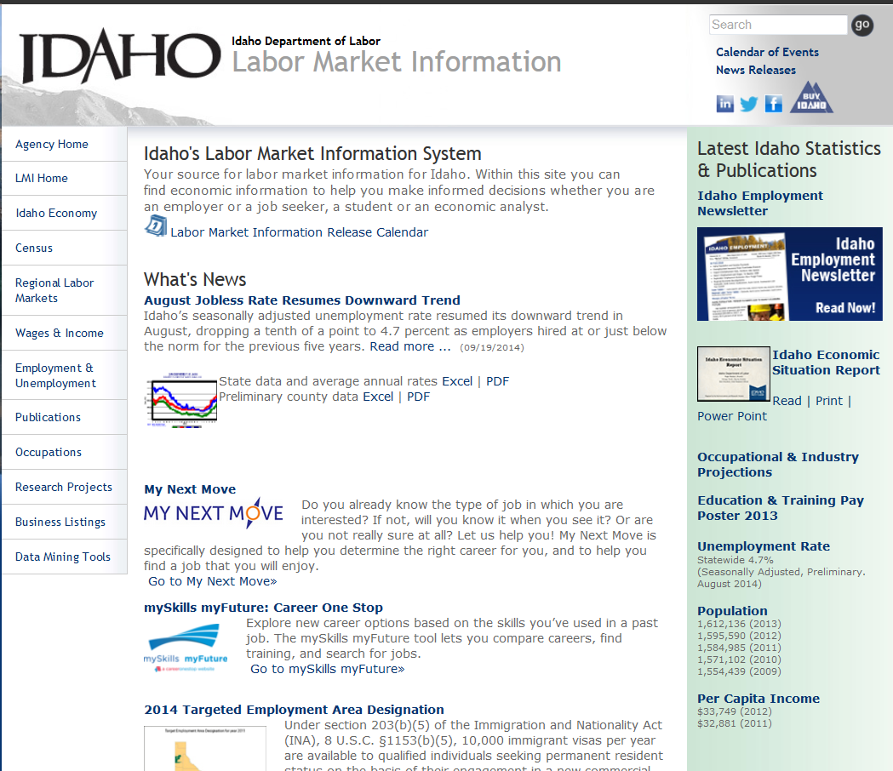
Visit labor.Idaho.gov for Idaho’s best source for:
Projections data:
Labor Market Information:
Career Information:
Notes:
Chris

Slide 17
On-the-Job Training
Money back in your pocket.

Slide 18
What is On-the-Job Training?
Funds to offset training costs
An opportunity to train employees your way
An investment in your company

Slide 19
How Does it Work?
Qualifying business hires eligible applicant.
Contract must be in place prior to first day of work.
Employee is trained on the job.
Employer submits invoice and receives payment within two to three weeks.

Slide 20
Who Can I Hire?
Applicants who are pre-screened by our office and referred to you.
OR
Applicants you send to us to screen. We notify you if they qualify.

Slide 21
How Long to Set it Up?
Within one week depending on response rates
Set up must take place prior to employee’s first day of work

Slide 22
Businesses May Qualify if…
The job opening is year-round and full-time
They have low employee turnover
The hourly wage is $10/hour or higher
The company realizes the benefit of investing in hands-on employee training

Slide 23
Workforce Development Training Funds (WDTF)

Slide 24
What is it?
Idaho’s Workforce Development Training Fund is a commitment by the State of Idaho to extend education and training resources to provide new or excising full-time employees with needed skills or upgrades.

Slide 25
Who may be eligible for WDTF?
A company who produces a product or service that is mainly sold (>51%) outside the region where the business is located; OR the company is in the Healthcare Industry
Starting wage of at least $12 an hour
The company provides medical benefits
The company is expanding and training new staff

Slide 26
Other Services – No Cost
Electronic Job Listings
Pre-Qualify Job Seekers
Job Fairs/Career Expos
Skills Testing
Customized Assistance
Resume Database
Wage Analysis
Labor Market Information

Slide 27
Thank you!
Christopher St Jeor - REGIONAL ECONOMIST
Christopher.StJeor@labor.idaho.gov
208.557.2500 ext. 3077
Megan Beyer - REGIONAL BUSINESS SPECIALIST
Megan.Beyer@labor.idaho.gov
208.557.2500 ext. 3311
Notes:
Chris

