Slide 1
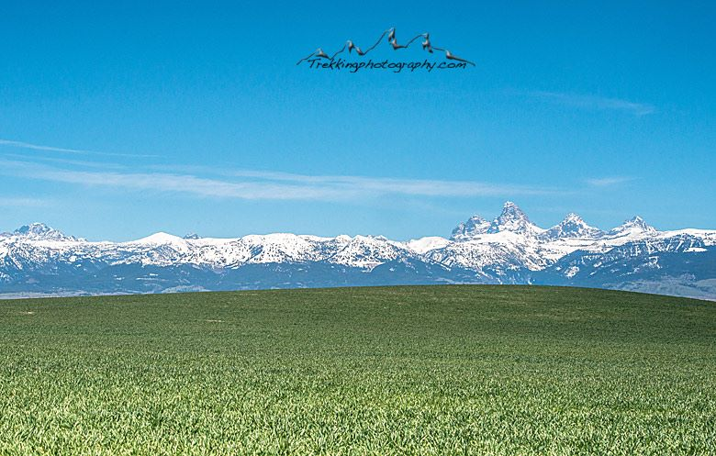
Economic Summit 2015

Slide 2
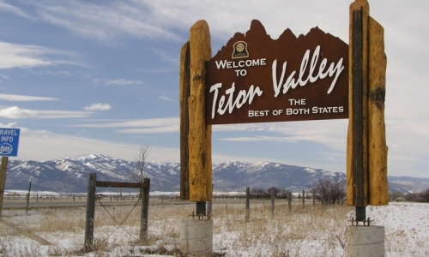
Our mission is "to support a vibrant economy through business partnerships and tourism in Teton Valley."
Our mission is "to support a vibrant economy through business partnerships and tourism in Teton Valley."

Slide 3
If you want to find the answers, you have to ask the questions. How do you think the Chamber is doing? What to do you need most? Are there any classes or workshops you would like to see?

Slide 4
More people spending!

Slide 5
Why we'll never be "Jacksonized," and why we don't need to be.

Slide 6
Adventure Tourism
Travelers have lost interest in cookie cutter attractions, lodging, and restaurants.
Defined as nature, culture, or physical activity.
It's a 263 Billion dollar industry
Another 82 Billion in Gear spending
Increase of 65% annually since 2009
54% of all current travel falls in this category
Average length of stay is 10 days

Slide 7
We already have all of this and MORE!

Slide 8
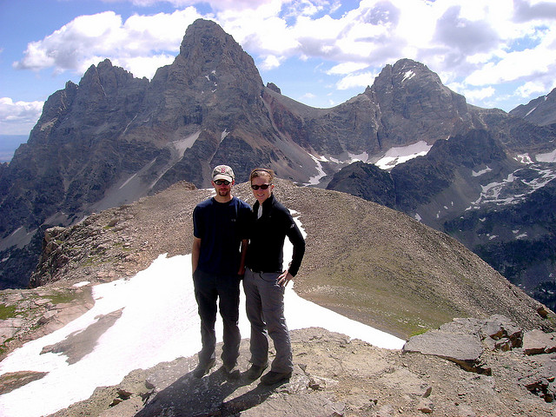
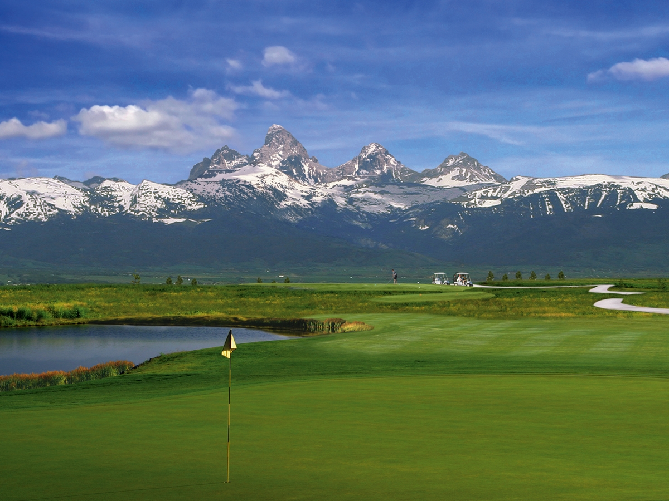
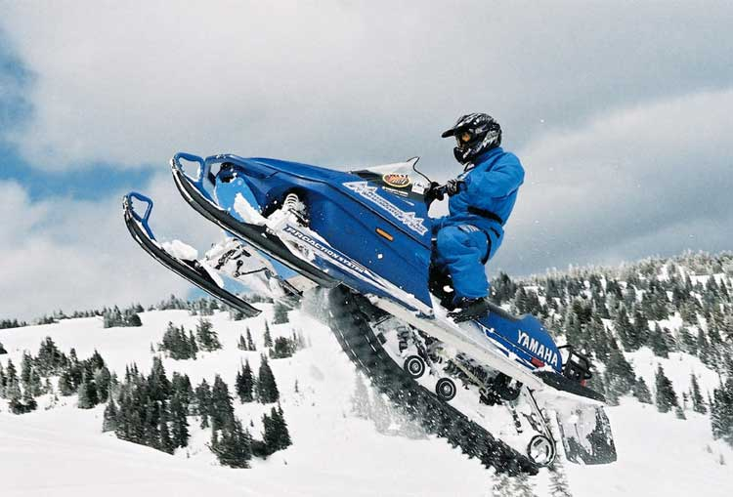
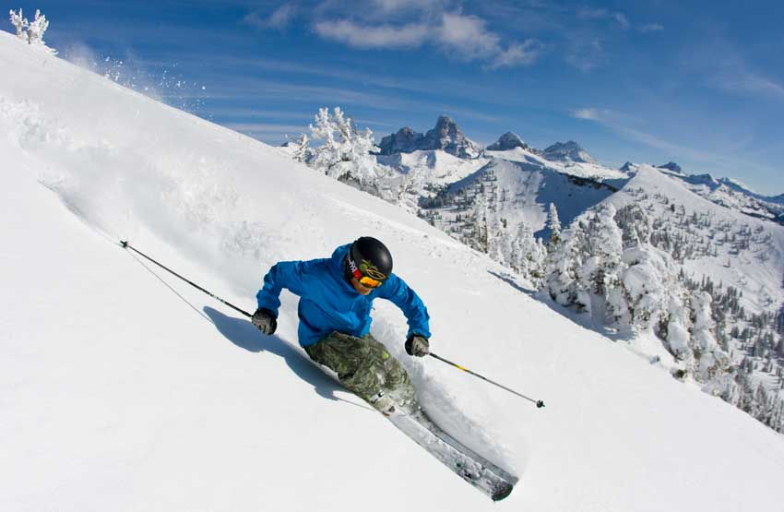
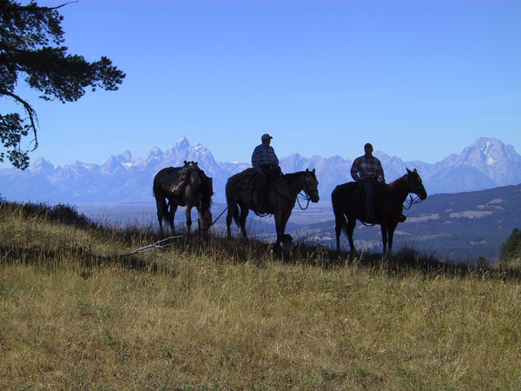
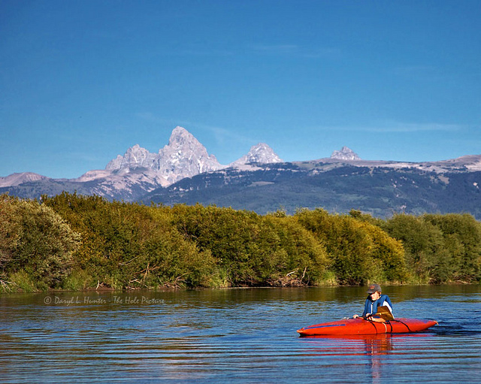
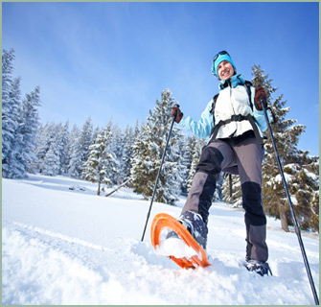
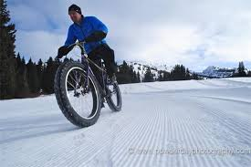
Unique outdoor recreation...

Slide 9
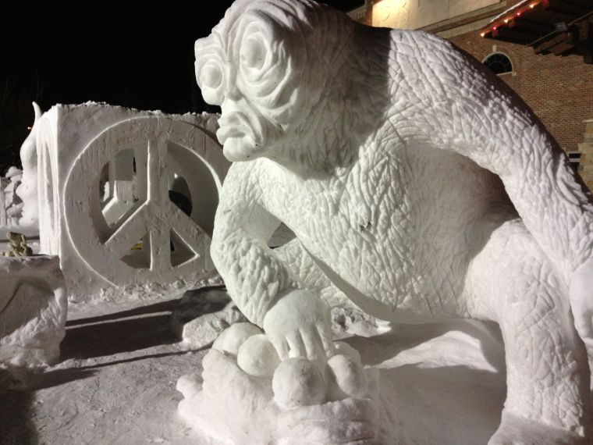
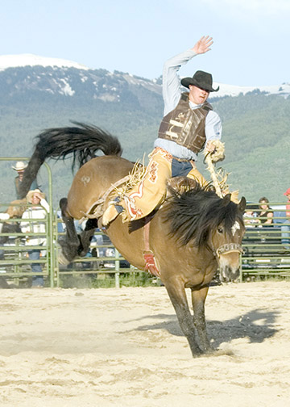
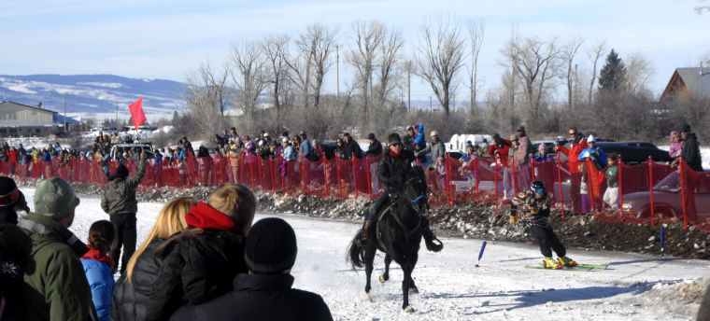
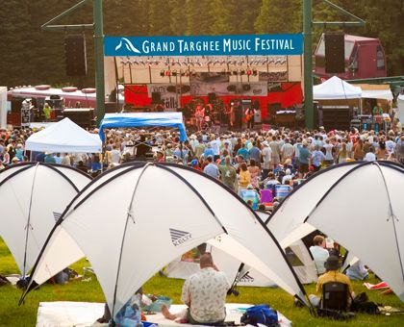
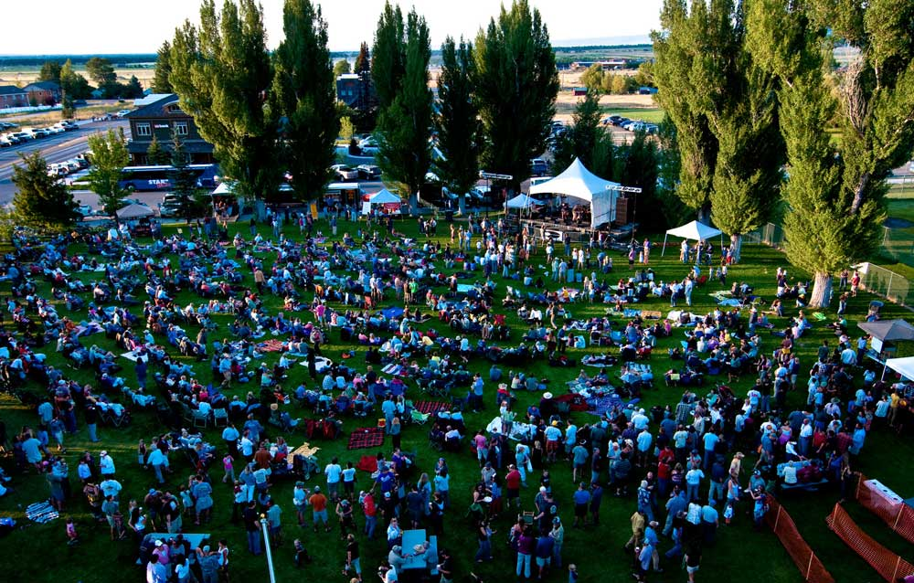
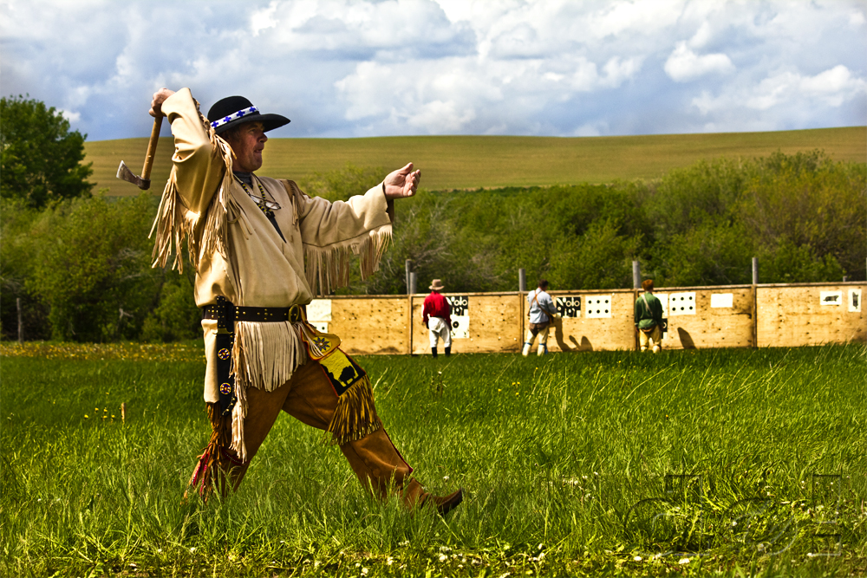
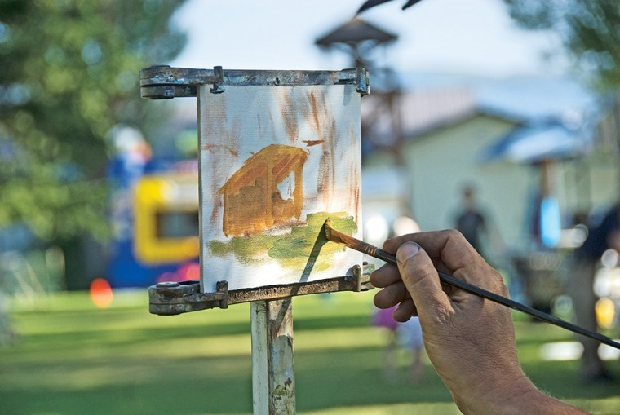
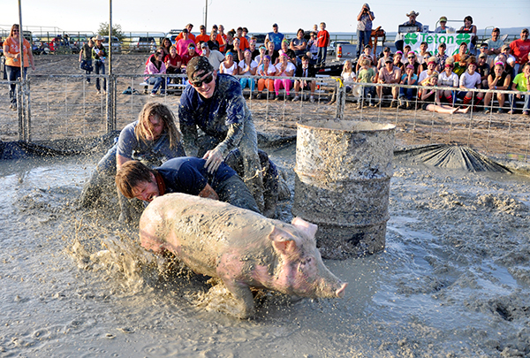
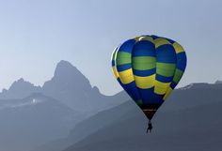
Unique Events and Experiences...
Music, races, festivals. They all have the ability to drive people here or extend their stay!

Slide 10
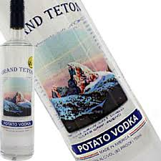
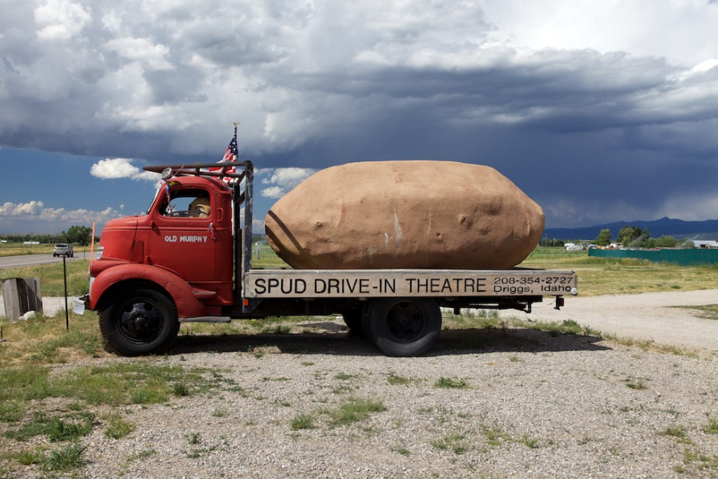
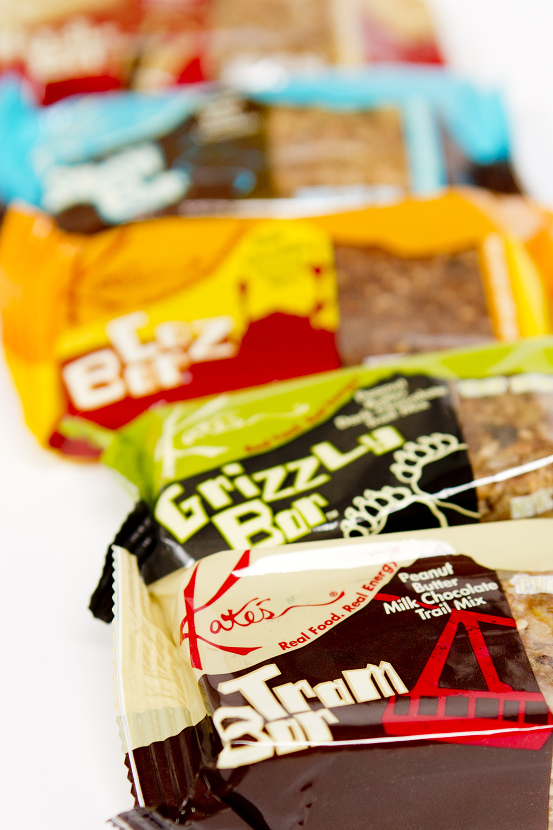
Don't forget our unique places and products

Slide 11
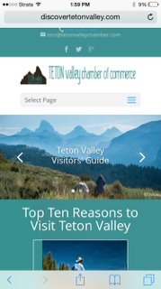
Where and how we advertise
Discovertetonvalley.com
Email campaigns
Social media outlets

Slide 12
Other Campaigns
18 Summers: Southeast Idaho

Slide 13
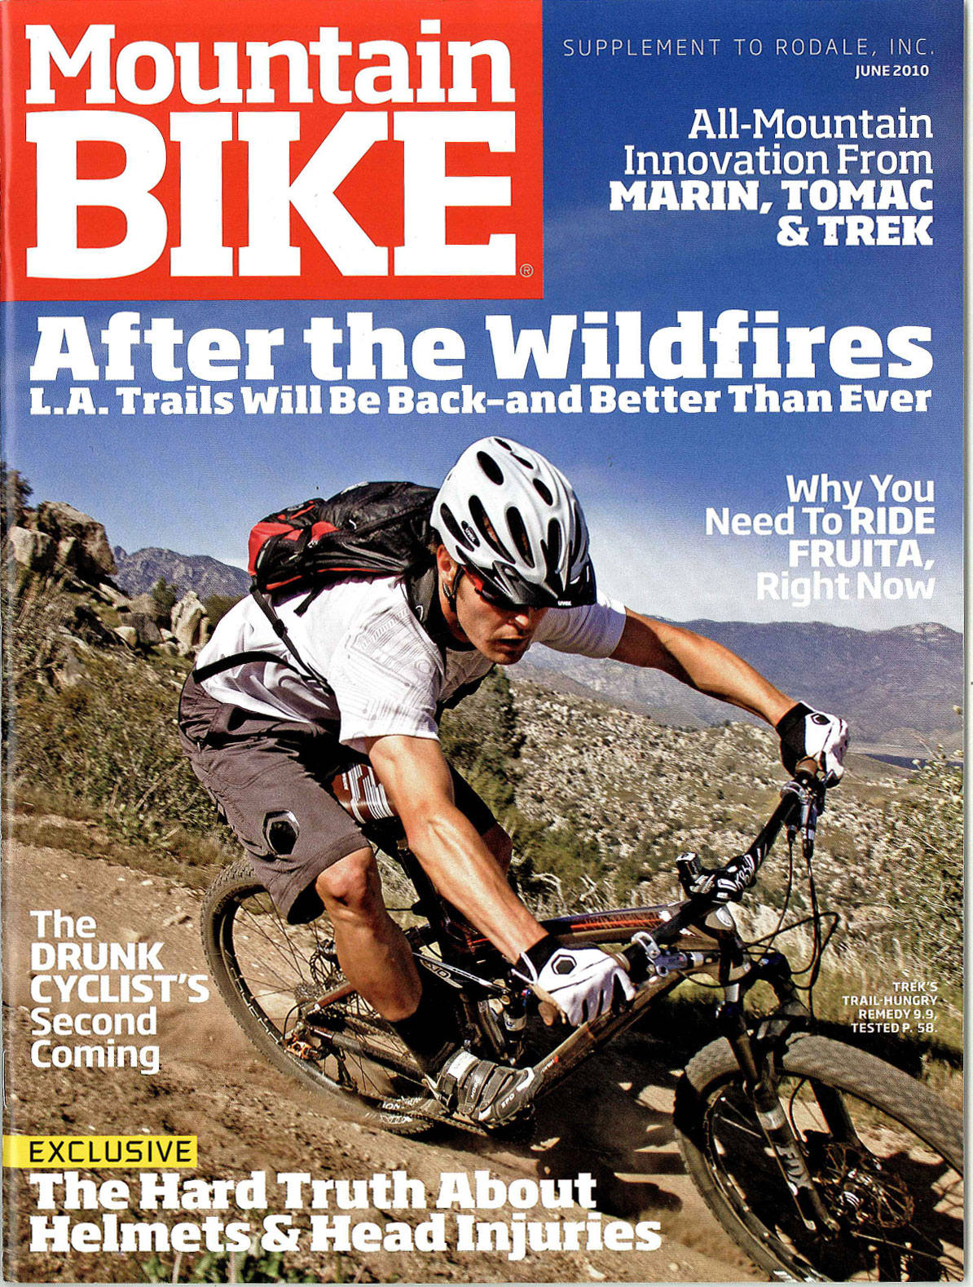
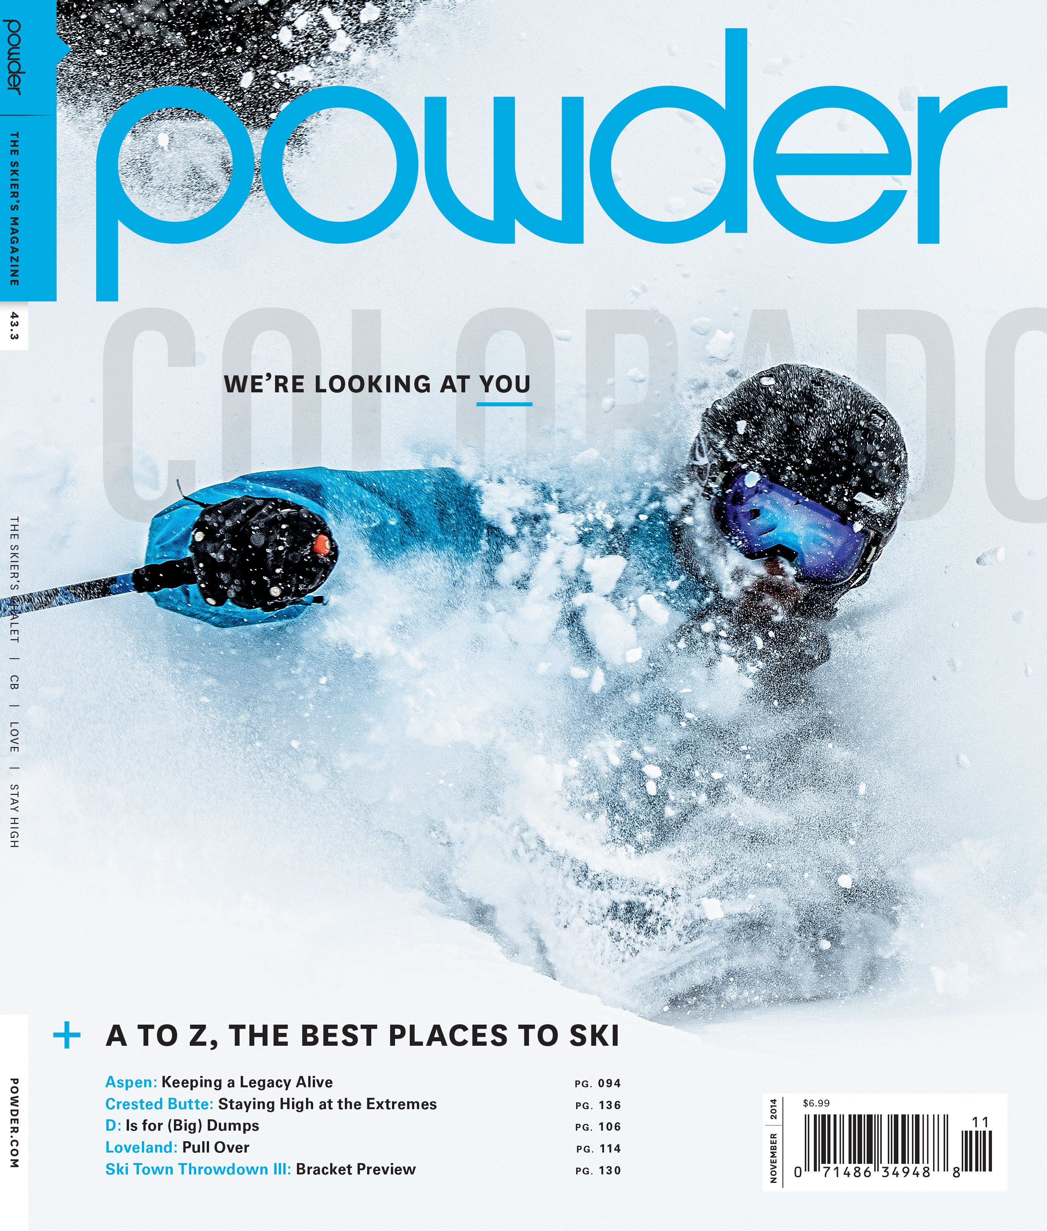
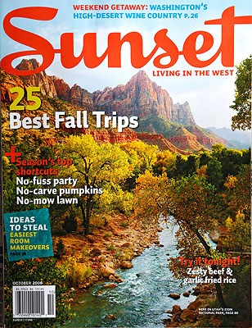
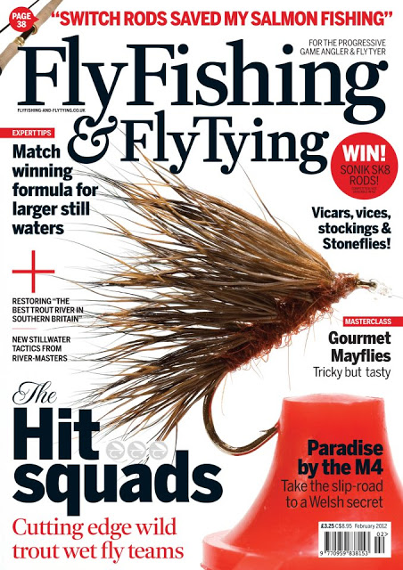
Recognitions, write ups, and winners of...

Slide 14
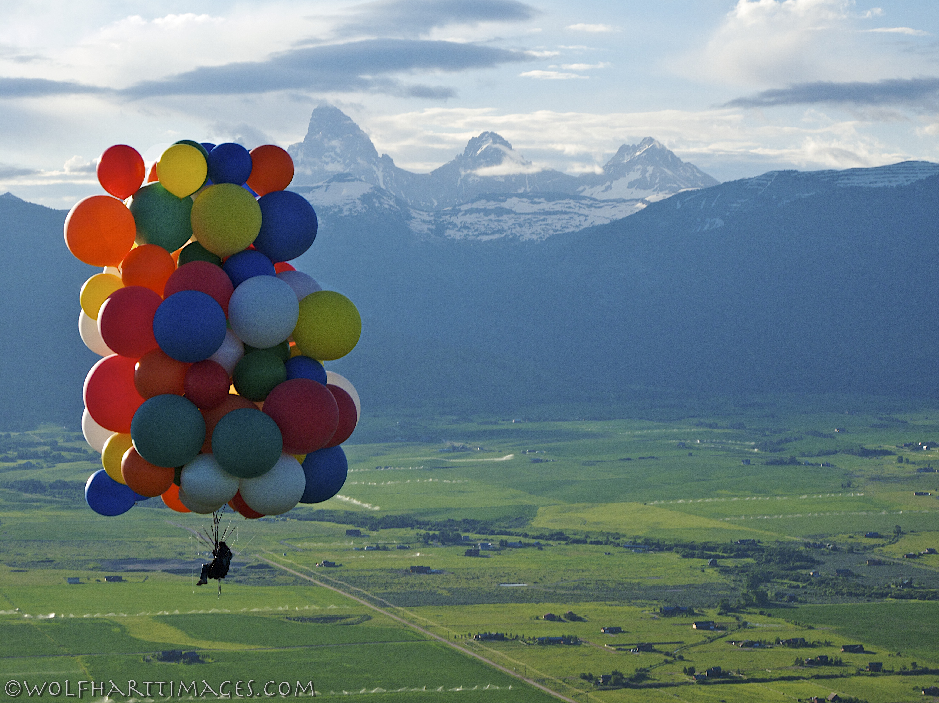
How can you help?
Share the discovertetonvalley website on all of your marketing campaigns
Use the hashtag #discovertetonvalley
Come to a board meeting
Send all events that you know of to TVCC@tetonvalleychamber.com
Coordinate events with other organizations for maximum impact
Come to a meeting, send suggestions, offer feedback, volunteer!

